Slide 1
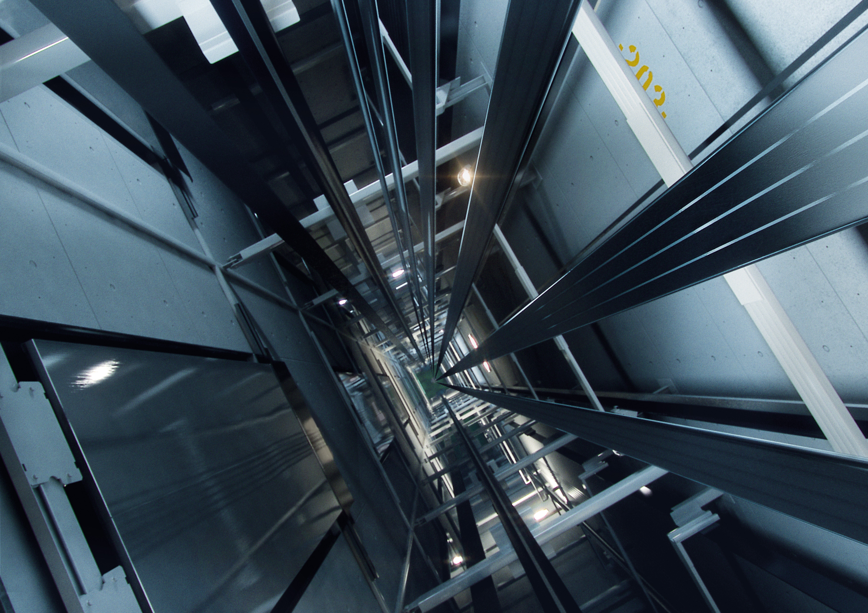
Team 404
Anush S Kumar
Sushrith Arkal

Slide 2
1.
Acoustics Based Condition Monitoring

Slide 3

What is Audio Fingerprinting?
A condensed digital summary, deterministically generated from an audio signal, that can be used to identify an audio sample or quickly locate similar items in an audio database.

Slide 4
The Setup
Audio Recording Device
The audio recording can be the CCTV’s internal mic
Lift car

Slide 5

What BIG IMPACT?
Why ?

Slide 6
2.
ETA and Vacancy Display

Slide 7
What are ETA and Vacancy?
Estimated arrival time of the car to the current floor along with an indication of vacant spots in the car.

Slide 8
The Setup
CCTV
Lift car

Slide 9
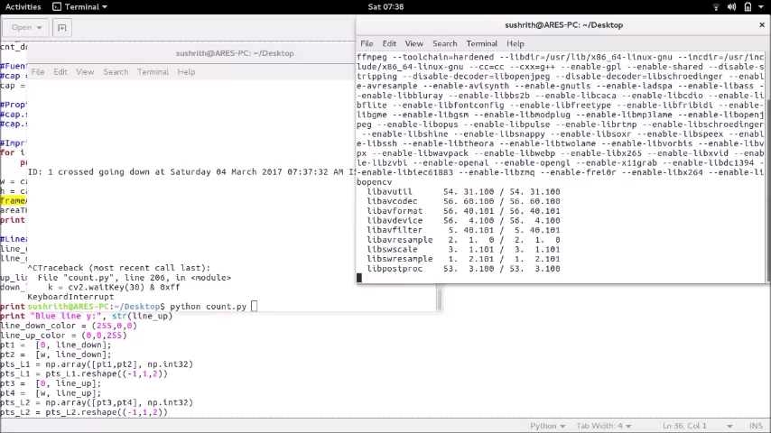
Demo

Slide 10

What BIG IMPACT?
Why ?

Slide 11
3.
User Feedback

Slide 12
The Setup
Display
Lift car

Slide 13

What BIG IMPACT?
Why ?

Slide 14

CTC

Slide 15
The Setup
Display
Mic
Microprocessor
CCTV
Lift car

Slide 16
THANKS!
Any questions?

